Slide 1
INF700 IT for Business and Management

Slide 2

Module 1 Data, Information and Knowledge
Module 2 Information Systems & Enterprise Strategy
Module 3 IS Infrastructure
Module 4 Business Process Management
Module 5 Information Systems Security

Slide 3

Module Information Systems and Enterprise Strategy

Slide 4
Plan for Today
Part 1- Ice breaker + Introduction to BIS (30 mins)
Part 2 – Data, Information and knowledge (1 hour, 30 mins)
Short Break (5 mins)
Part 3 - Strategy and competitiveness (1 hour, 30 mins)
Levels of Strategy
Developing Strategy
Environmental Analysis

Slide 5
Introduction to BIS as Strategy

Slide 6




Aligning IT to Business Strategy
IT-business strategy alignment should consider internal and external opportunities as well as resource requirements.
Michael Porter, of the Harvard Business School, states that corporations need to incorporate IT into their business strategy formulation rather than focus on IT’s operational role.
Technology strategy and business strategy need to be orchestrated prior to deploying IT.

Slide 7
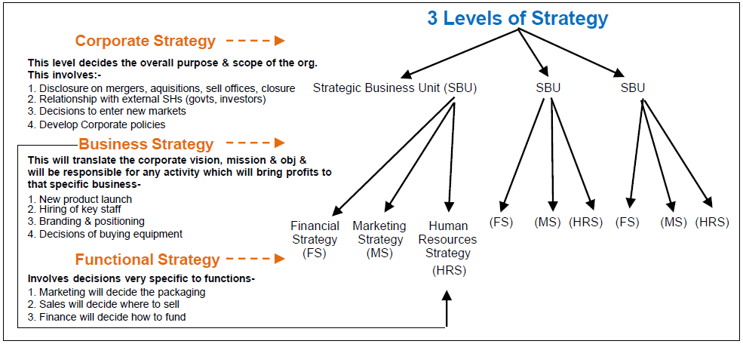
Levels of Strategy

Slide 8
3 Levels of Strategy – Johnson & Scholes
Corporate Strategy – Looks at the industries in which the organisation operates. This may mean deciding to leave existing area or enter new ones. This is particularly true if the organisation has a number of divisions
Business Strategy – looks at how the organisation (or subsidiary/division) competes. This tends to mean either:
The division is trying to win customers by being better than rivals in some way (differentiation/focus as strategy)
OR,
The subsidiary is trying to win customers by being cheaper than rivals (cost leadership).
3. Operational Strategy – looks at how resources are used to carry out the strategies noted above

Slide 9
What is Strategy?
Strategy can be defined as:
‘the direction and scope of an organisation over the long term, which achieves advantage in a changing environment through its configuration of resources and competencies with the aim of fulfilling stakeholder expectation
Simply put, strategy is how an organisation attempts to meet its objectives

Slide 10
Two Approaches to Strategy
1. Strategic Planning – involves formal analysis of each of the stages in strategic position before a final strategic option is chosen
Used in public sector, justify actions, considers all aspects of biz, proactivity
2. Free-wheeling opportunism – means having no long term strategic plan, in effect, making up the strategy as the organisation goes along
Quick response, etc.

Slide 11
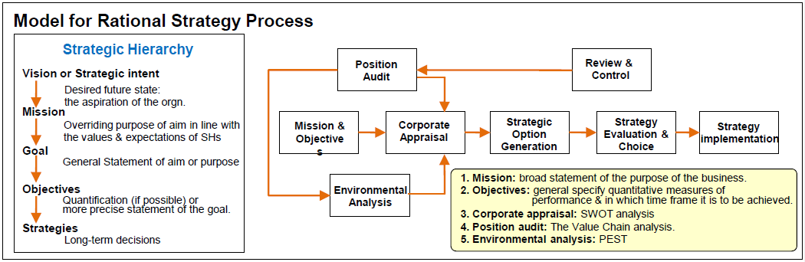
Old School Approach to Strategy?

Slide 12
More Approaches to Strategy?
Position-based strategy – organization that is responding to changes in the external environment (reacting to or anticipating opportunties and threats)
Resource-based strategy – organisation that concentrates on gaining an advantage because of its own strengths. These resources must be:
(1) valuable, (2) rare, (3) imperfectly imitable (tough to imitate), and (4) non-substitutable.

Slide 13
Three Lenses Approach to Developing Strategy?
Strategy as design – driven from the top
Strategy as experience – repeating what worked in the past
Strategy as ideas – encourage innovation

Slide 14
Environmental scanning

Slide 15
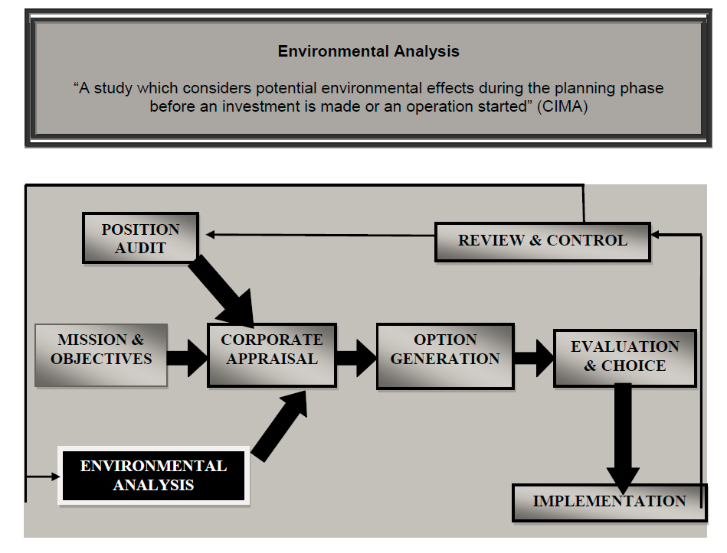
Environmental Analysis

Slide 16
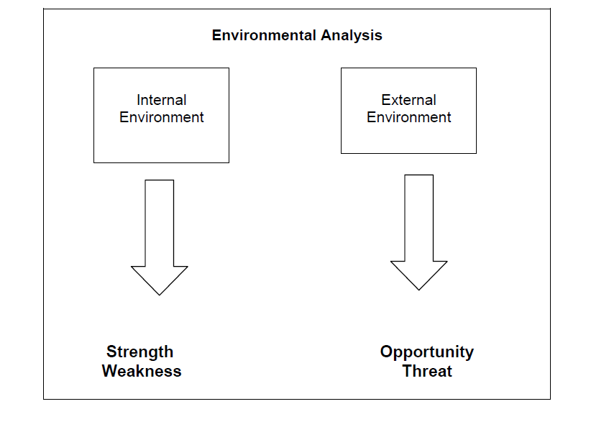
Environmental Analysis

Slide 17
Environmental Analysis
Organisations are strongly affected by their environment – essentially the world around them:
EXTERNAL environmental analysis – looks at the OPPORTUNITIES and THREATS
INTERNAL environmental analysis – looks at the STRENGTHS and WEAKNESSES

Slide 18
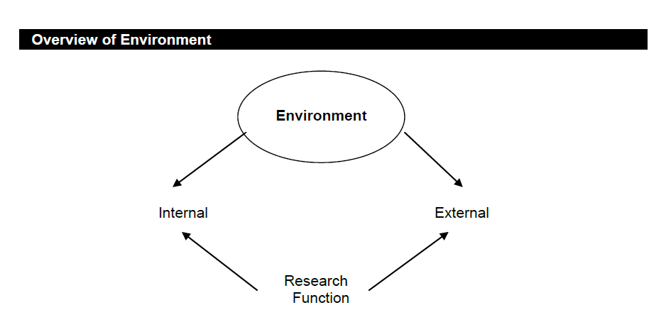
Environmental Analysis

Slide 19
Strategic Analysis Tools/Models

Slide 20
SWOT

Slide 21
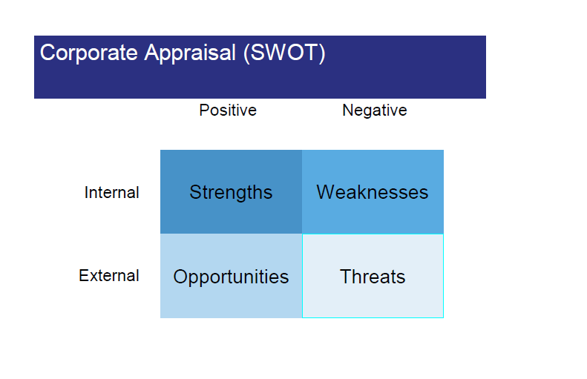
SWOT

Slide 22
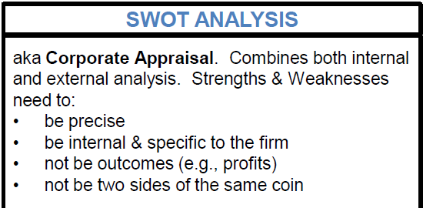
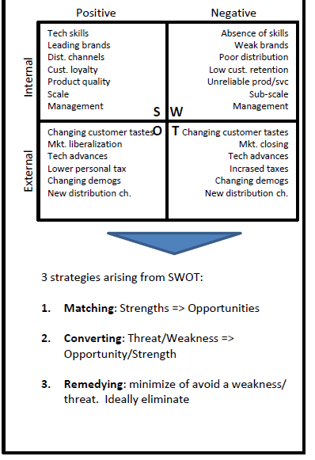
Internal | External
Strengths | Opportunities
Things we are doing well Things we are doing that the competition are not Major successes | Events or changes in the external environment that can be exploited Things likely to go well in the future
Weaknesses | Threats
Things we are doing badly Things we are doing badly (need to correct) Major failures | Events or changes in the external environment we need to protect ourselves from or defend ourselves against Things likely to go bad in the future

Slide 23
The FreshDirect Case-
Group Activity
4 Groups (15 minutes)
Each group covers a theme each:
Strengths
Weaknesses
Opportunities
Threats
Link to Case
FreshDirect & Suppliers' Web site from Here

Slide 24
The FreshDirect Case
The FreshDirect Case - Strategic Positioning
FreshDirect Web address
Partnership with suppliers
Dell’s struggles as computers, customers, and the product mix changed, all underscore the importance of continually assessing a firm’s strategic position among changing market conditions.
There is no guarantee that today’s winning strategy will dominate forever

Slide 25
The FreshDirect Case
SWOT – FreshDirect- Matching/Converting
Internal | External
Strengths | Opportunities
web-store front: one-click menus with semi-prepared meals -'Meals in 4 mins':ability to pull up prior grocery lists Firm's Iphone app vast warehouse in lower rent industrial area of queens next-day deliveries Short supply chain - Fresh goods selection from warehouse larger than local supermarket Artificial Intelligence software+some seven miles of fibre-optic cables linking systems and sensors, and supporting everything from bakin gto verifying orders benefits to suppliers -no middlemen no 'slotting fees' by suppliers 600,00 payingn cutomers Scale advantages – economies of scale | High prices of substitute products limited selection for buyers in brick and mortar stores time-strapped Manhattanites area shoppers without cars and keen to avoid traffic jams web not being only channel to reach customers apartments in NYC redesigned to receive deliveries of absent customers using secured freezers. High entry barriers high switching costs
Weaknesses | Threats
low pricing capital outlay against revenue stream | replication of business model traffic situation and product transportation+supply challenges suppliers Short shelf life of food products

Slide 26
PESTEL

Slide 27
PESTEL
P - Political
E - Economic
S - Social
T - Technological
E - Environmental
L - Legal

Slide 28
Porter’s Five Forces

Slide 29
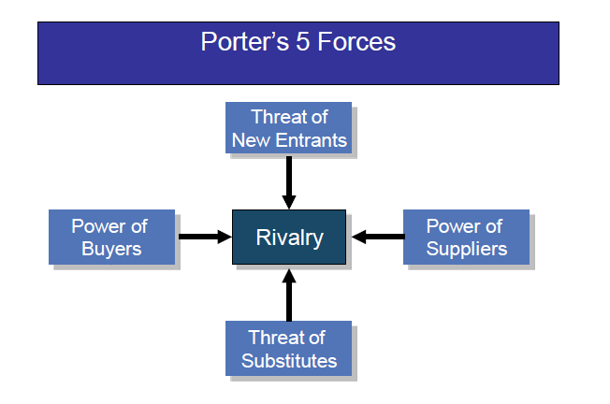
Porter’s 5 Forces

Slide 30
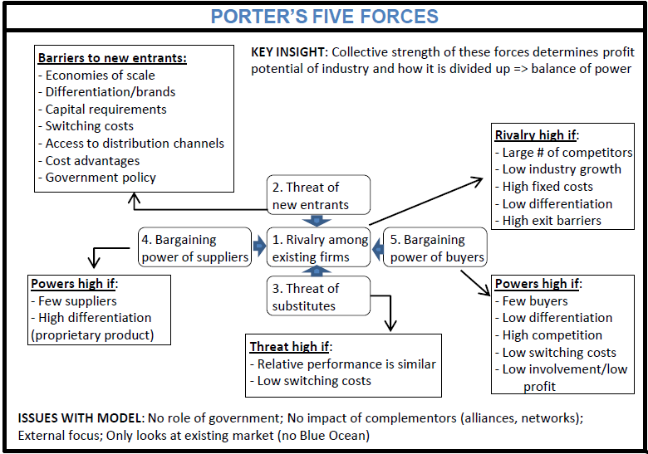
Porter’s Five Forces

Slide 31
The FreshDirect Case
The FreshDirect Case - Strategic Positioning
FreshDirect Web address
Partnership with suppliers

Slide 32
1. Competitive Rivalry -low | 3. Bargaining Power of Buyers – Low
No viable competitors Low industry growth High fixed costs*- high delivery costs with low margins High differentiation -excellent packaging and delivery with convenience.No phy. store Low/No competition High exit barriers | Many buyers – large customer base High product differentiation – excellent packaging and delivery with convenience Low competition High switching costs – buying a car, traffic jams and old produce having been on shelf longer
2. Threat of New Entrants – Low | 4. Threat of Substitutes –Low
Barriers to Entry Scale advantages – serving 600,000+ customers Differentiation – offering fresh farm produce, reputation for delivery Capital requirements - the firm spent 75 million dollars building infrastructure before it could serve a single customer Access to distribution channels – offering benefits to suppliers. Partnerships with suppliers Cost advantages – low cost strategy | Store - with old produce High switching costs
 | 5. Bargaining power of suppliers - high
 | Many suppliers - deals Option to switch into clent's business – forward intergration
The FreshDirect Case – Solution
Using the Porter’s 5 Forces

Slide 33
McFarlan’s Strategic Grid

Slide 34
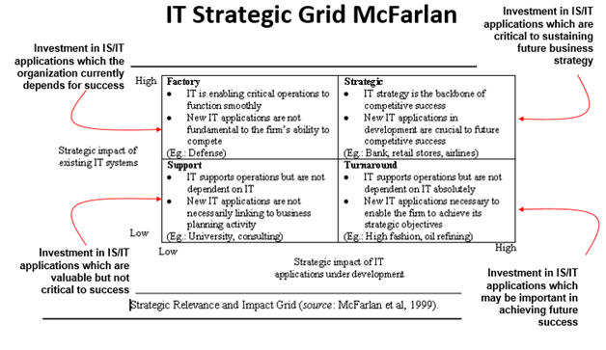
MacFarlan’s Grid

Slide 35
MacFarlan’s Grid
It is a model used to indicate the strategic importance of information systems to a company now and in the future. It is sometimes referred to as an APPLICATIONS PORTFOLIO model since it assesses the current mix of business information systems within an organisation. It was developed by McFarlan and McKenney (1993)
Strategic segment - indicates that the business depends on both its existing IS and its continued investment in new IS to sustain continued competitive advantage.
Turnaround segment – suggests that while a business in this position does not currently derive significant competitive benefits from its current IS, future investment in this area has the potential to positively affect the business’ competitive position
Factory segment – for a business operating in this segment, while depending on its current IS to operate competitively, does not envisage further IS investment having a positive impact on its competitive position
Support segment - does not believe it will derive significant competitive advantage from IS.

Slide 36
Value Chain – Position Audit Critical Success Factors (CSFs) Ansoff’s Growth Strategies

Slide 37
Porter’s Value Chain

Slide 38
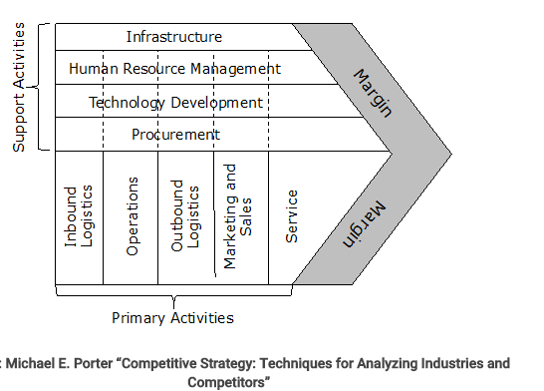
Porter’s Value Chain

Slide 39
More Approaches to Strategy?
It is an analytical framework for decomposing an organisation into its individual activities and determining the value added at each stage.
Makes a distinction between:
primary activities – which contribute directly to getting goods and services closer to the customer (physical creation of a product, marketing and delivery to buyers, support and servicing after sales), and
Inbound logistics – receiving, storing and expediting materials to the point of manufacture of the goods or service being produced
Operations – transforming the inputs into finished goods or services
Outbound logistics - storing finished products and distributing goods and services to the customer
Marketing and sales - promotion and sales activities that allow the potential customer to buy the product or service
Service – after-sales service to maintain or enhance product value for the customer

Slide 40
More Approaches to Strategy?
2. Support activities - which provide the inputs and infrastructure that allow the primary activities to take place
Corporate administration and infrastructure – This supports the entire value chain and includes general management, legal services, finance, quality management and public relations
Human Resource Management – Activities here includes staff recruitment, training, development, appraisal, promotion and rewarding employees
Product Technology/development - this includes development of the technology of the product or service, the processes that produce it and the processes that ensure the successful management of the organisation. It also includes traditional research and development activities
Procurement - This supports the process of purchasing inputs for all the activities of the value chain. Such inputs might include raw materials, office equipment, product equipment and information systems.

Slide 41
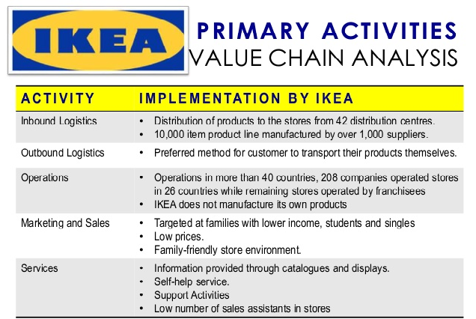
Using the Value Chain Analysis – IKEA Example

Slide 42
Using the Value Chain Analysis – FreshDirect
When we compare FreshDirect’s value chain to traditional rivals, there are differences across every element.
But most importantly, the elements in FreshDirect’s value chain work together to create and reinforce competitive advantages that others cannot easily copy.
Incumbents would be straddled between two business models, unable to reap the full advantages of either.
And late-moving pure-play rivals will struggle, as FreshDirect’s lead time allows the firm to develop brand, scale, data, and other advantages that newcomers lack

Slide 43
Critical Success Factors

Slide 44
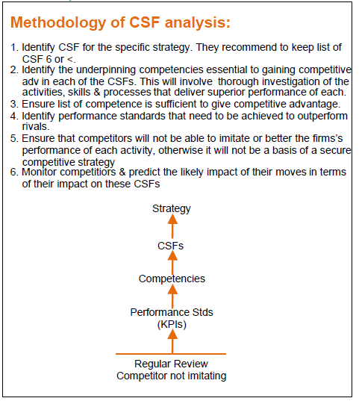
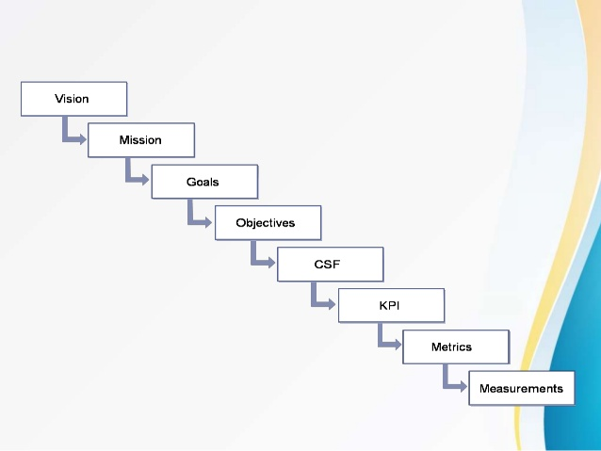
CSFs

Slide 45
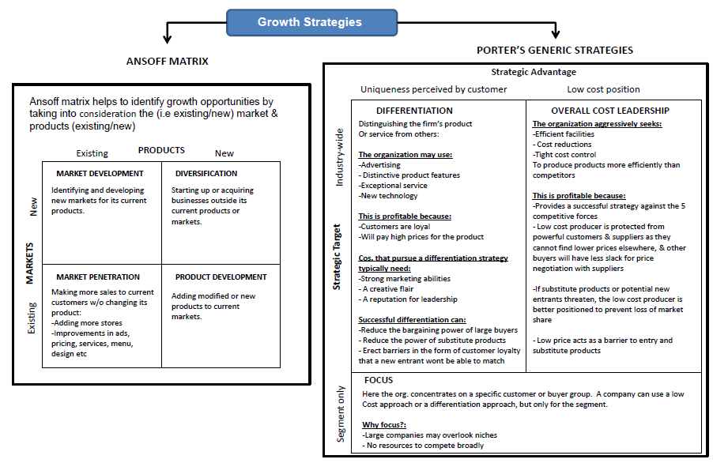
Ansoff’s Matrix & Porter’s Generic Strategies

Slide 46
Information Strategy, Systems & technology

Slide 47
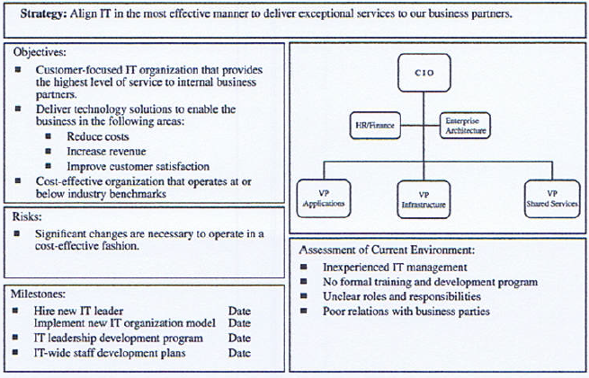
Information Strategy Companies need to develop a plan to link its business and information strategies and the model below shows how this can be done: An example of an IT strategy

Slide 48
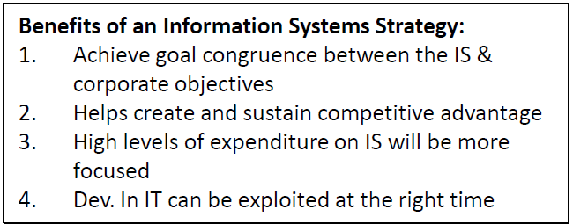
Information Strategy

Slide 49
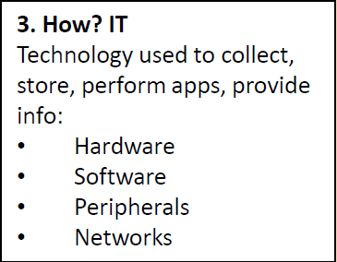
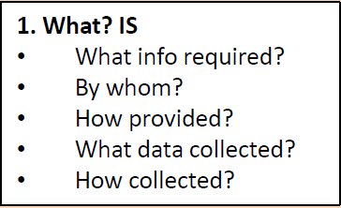
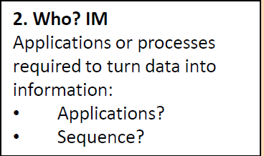
3 Elements of IS Strategy

Slide 50
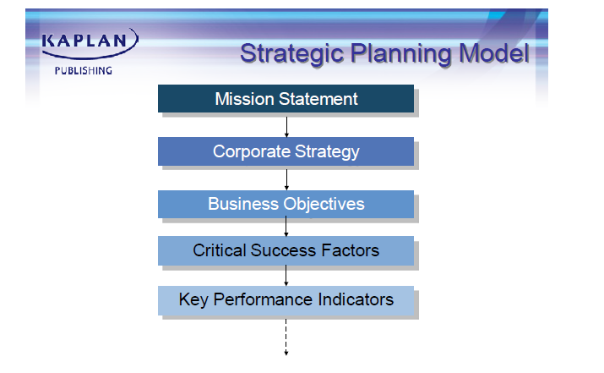
Strategic Planning Model

Slide 51
Information Strategy in the --- Strategic Planning Model
The link between the corporate strategy and the information needs is often established by considering Critical Success Factors (CSFs) for the organisation.
The organisation will need information on the key performance indicators (KPIs) to ensure that the CSFs are being achieved and, as a result, that the business aims are being achieved.
The information needs of the organisation then drive the information strategy and the information systems created.

Slide 52
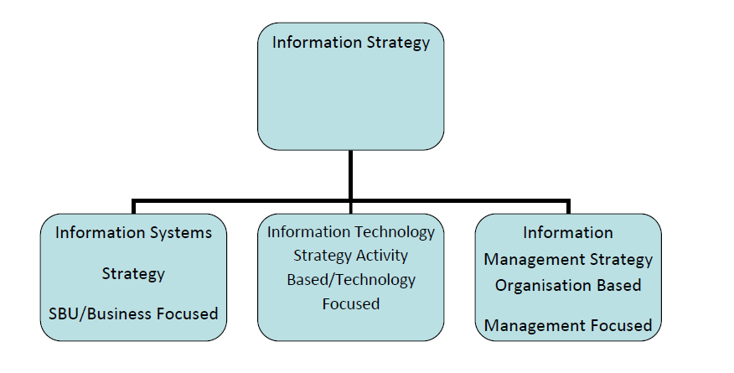
Information Strategy Components
The Information Strategy is the overall plan a business has to create and develop its information systems. Its broken into 3 parts:

Slide 53
Information Strategy Components
The difference between the three components are summarised below:
IS Strategy – looks at the way in which information systems in various parts of the organisation are organised.
IT Strategy - looks at the technology infrastructure of the systems
IM Strategy - considers how the systems support management processes

Slide 54
Levels of Management(recap) & BIS

Slide 55
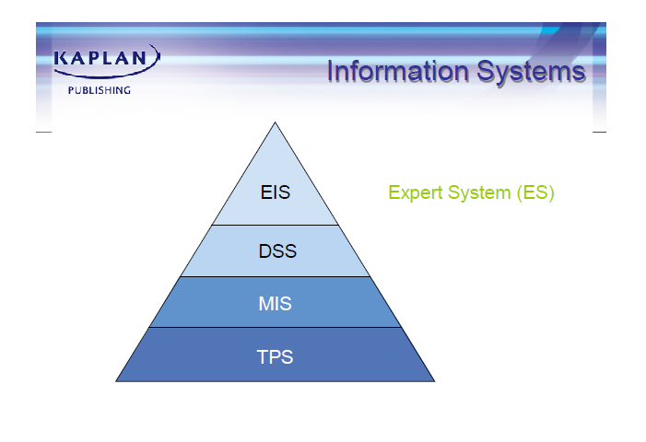
Information Systems Pyramid

Slide 56
IT Governance & Business Operating Models

Slide 57
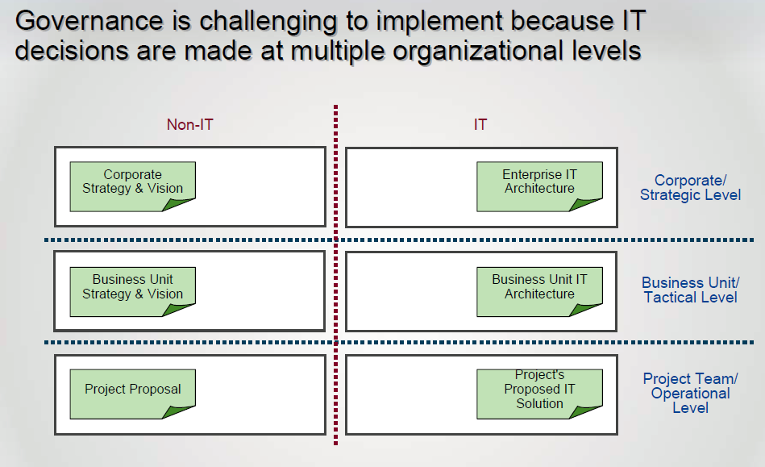
IT Governance

Slide 58
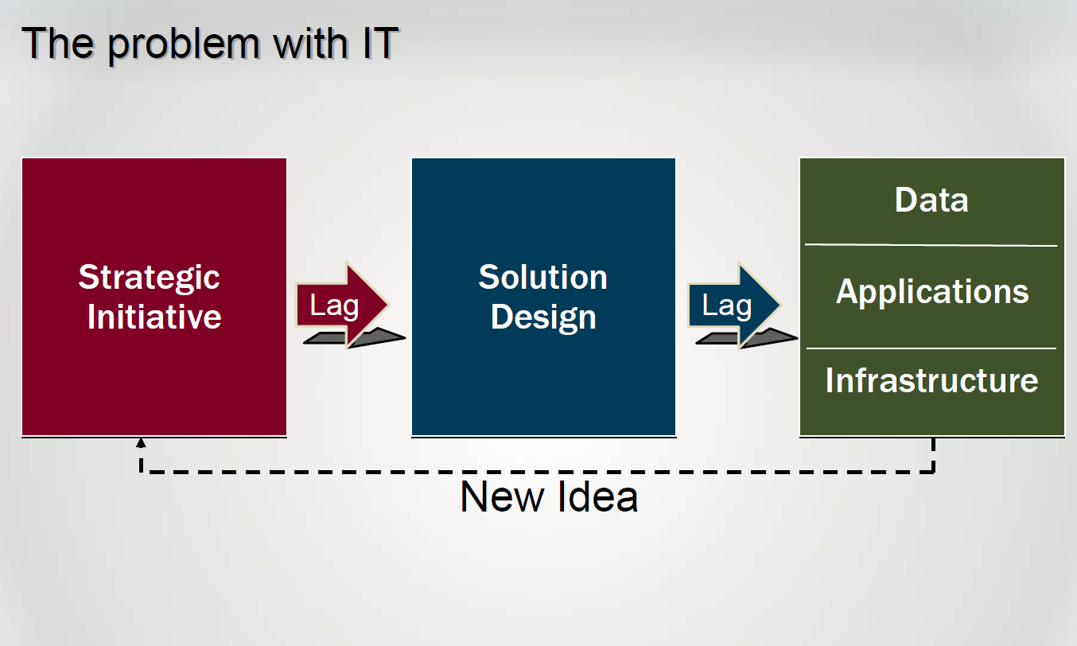
The problem with IT

Slide 59
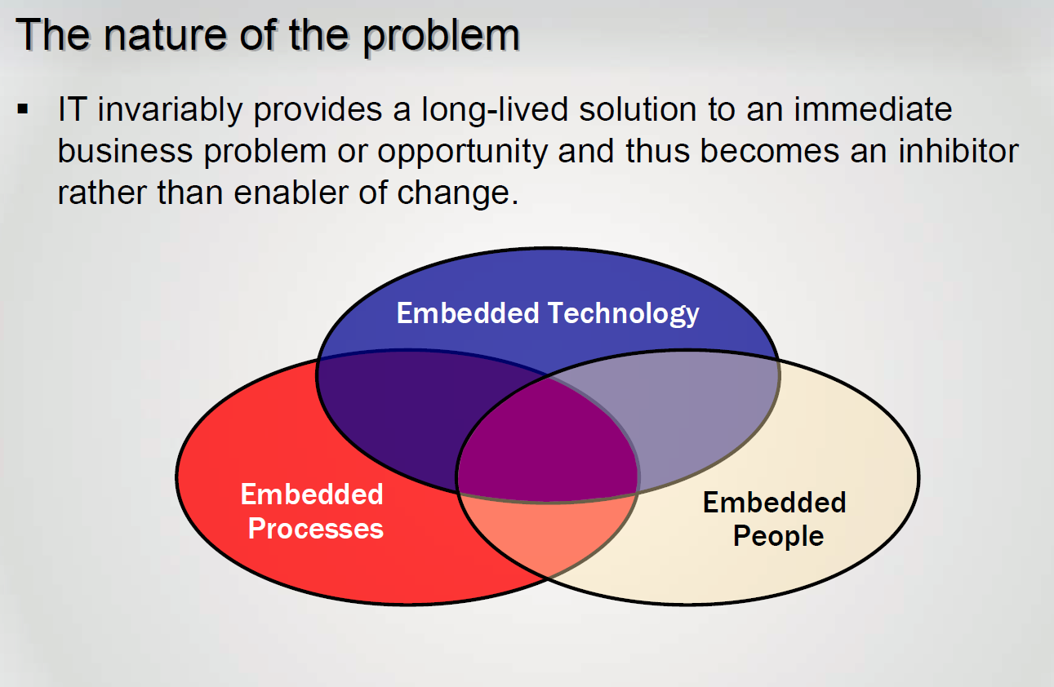
The problem with IT

Slide 60
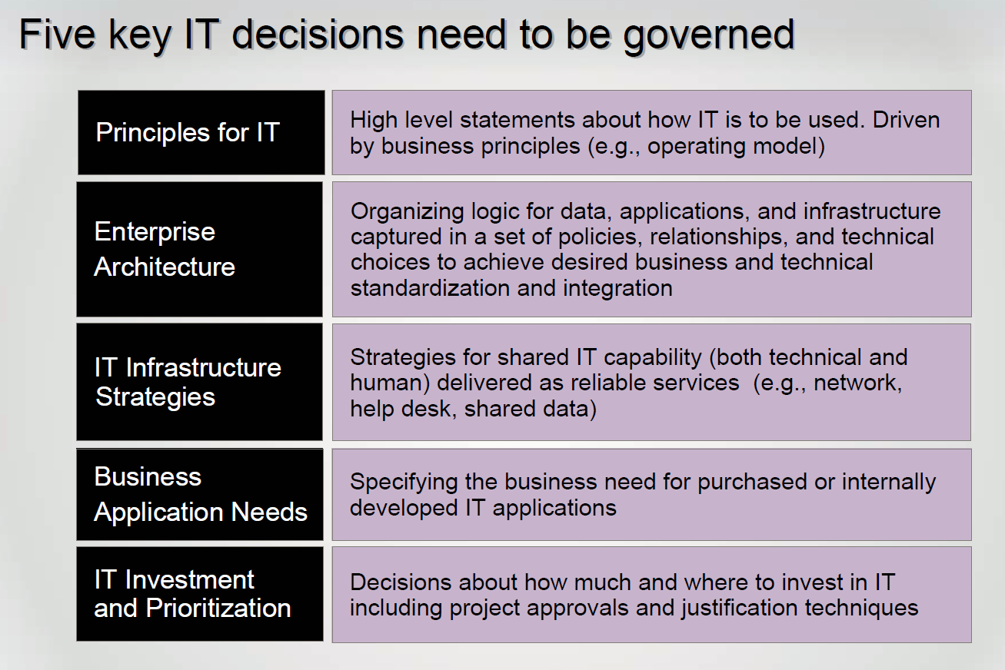
IT Governance – Framework for decision rights and accountability to encourage desirable behavior in the use of IT. Governance complements organizational structure to enable a firm to meet conflicting objectives.

Slide 61
Making IT an ASSET Depends on.....
Operating Model
IT governance and decision making processes
Development and management of a digitized platform

Slide 62
Integration & Standardisation
Key Dimensions of an Operating Model
An Operating Model has two dimensions:
Business process standardisation;
Business process integration

Slide 63
The four general types of operating models are:
Diversification (low standardization, low integration)
Coordination (low standardization, high integration)
Replication (high standardization, low integration)
Unification (high standardization, high integration)

Slide 64
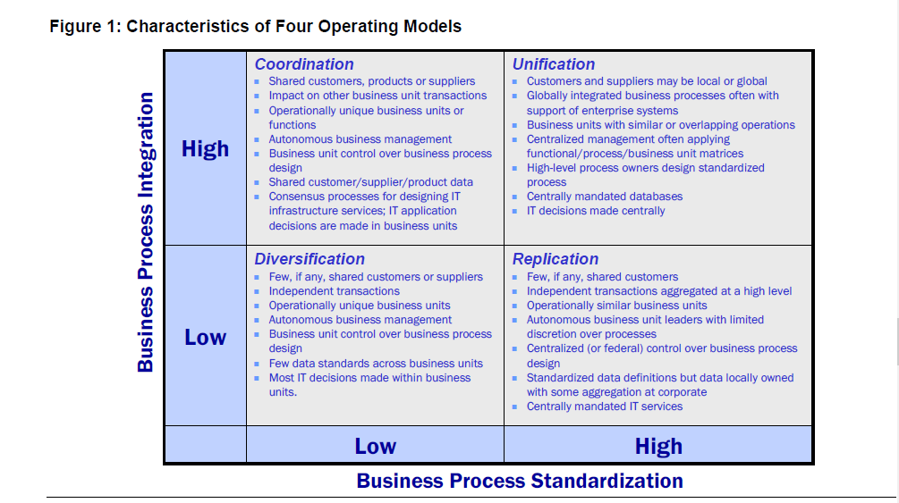
Operating Model – the desired level of business process integration and business process standardization for delivering goods and services to customers. It describes how a firm will profit and grow.

Slide 65
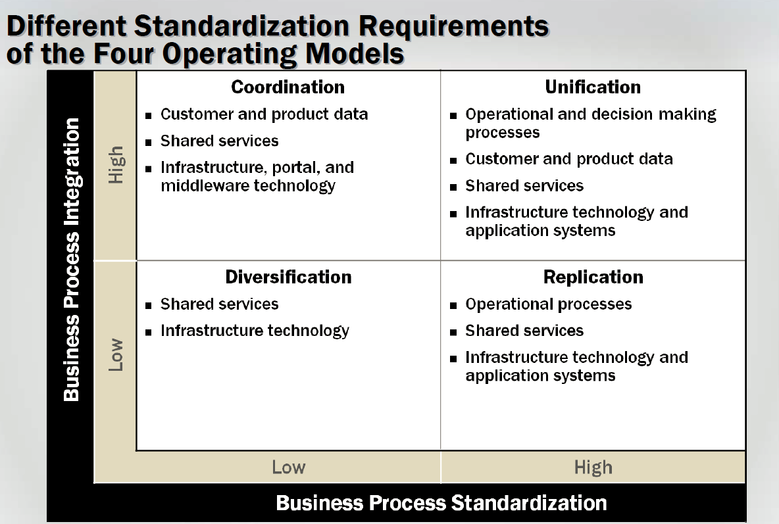
Operating Model – the desired level of business process integration and business process standardization for delivering goods and services to customers. It describes how a firm will profit and grow.

Slide 66
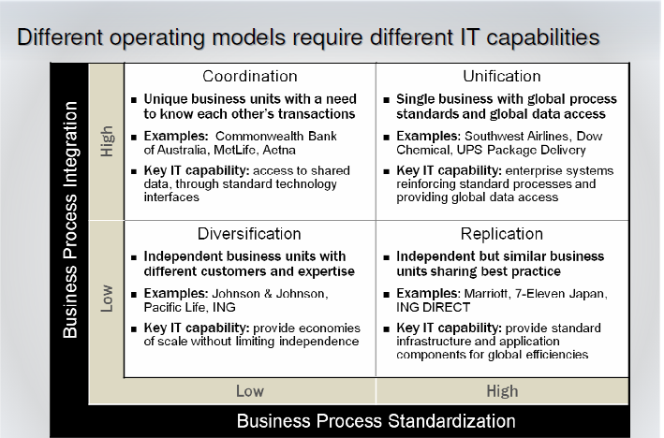
Operating Model – the desired level of business process integration and business process standardization for delivering goods and services to customers. It describes how a firm will profit and grow.

Slide 67
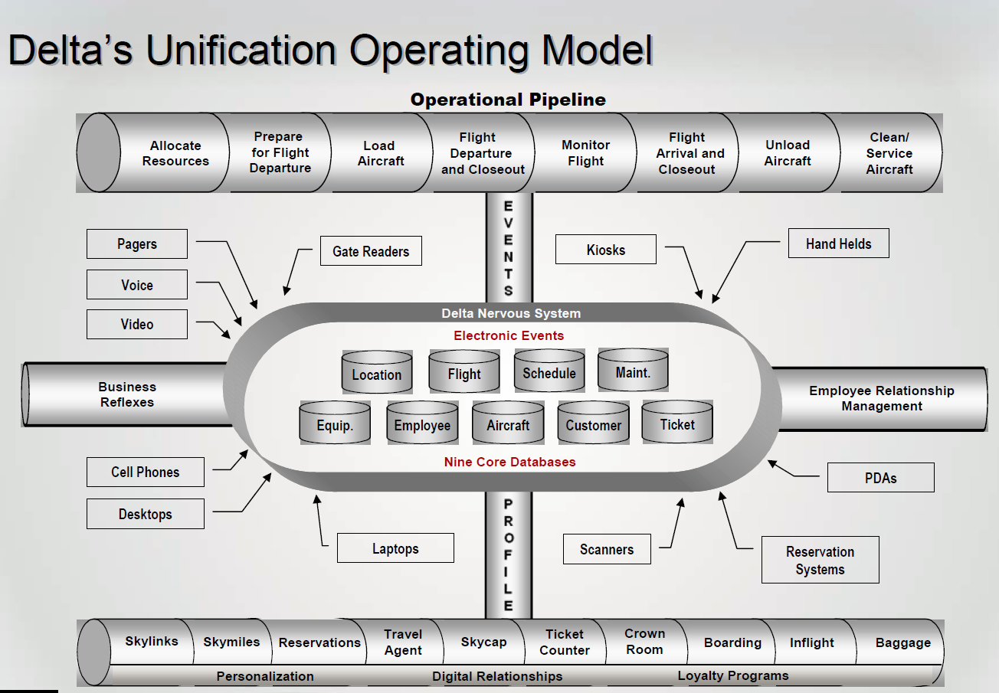
Operating Model – the desired level of business process integration and business process standardization for delivering goods and services to customers. It describes how a firm will profit and grow.

Slide 68
Capabilities provided by Unification Model
Scale: supports efficient, reliable global operations
1
End-to-end visibility of business processses
2
Availability of data to provide customer service information and analyse pricing, scheduling, etc.
3
Rapic expansion of existing processes to new markets or for related products and services
4
supports integration of acquisitions of competitors
5

Slide 69
Risks and Limitations of Unification Model
Highly IT dependent, needs sophisticated back up and recovery
Locks in existing business processes and data definitions; not flexible for related products and services demanding different types of business processes
IT can become monolithic and slow
Demands enormous organisational discipline and this is difficult to implement

Slide 70
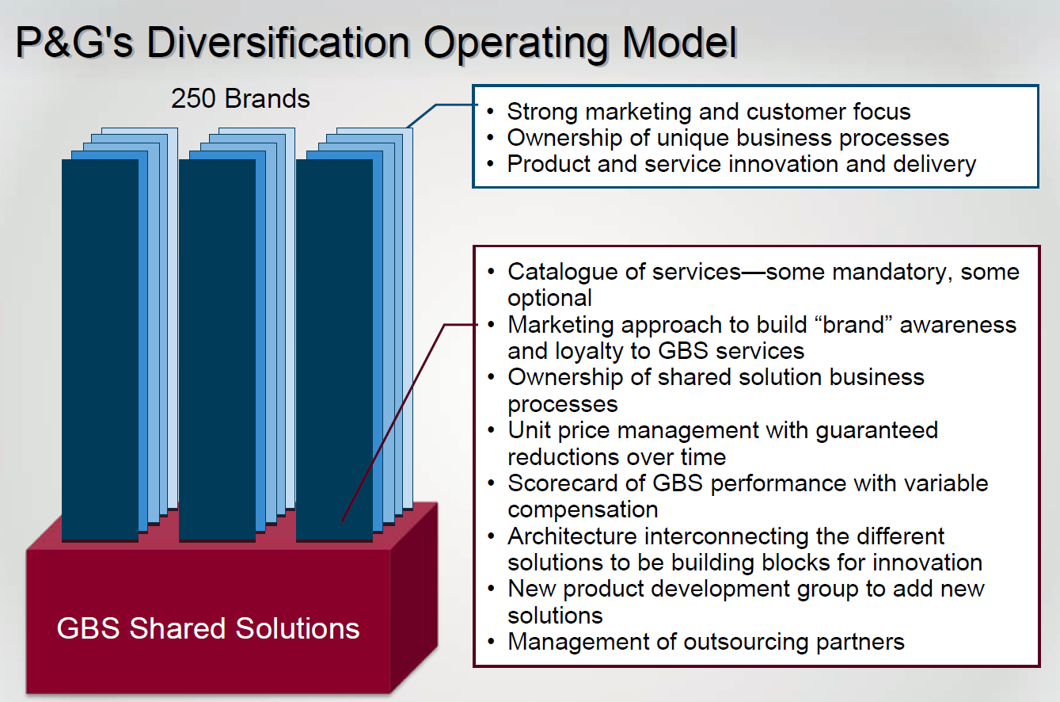
Diversification Model

Slide 71
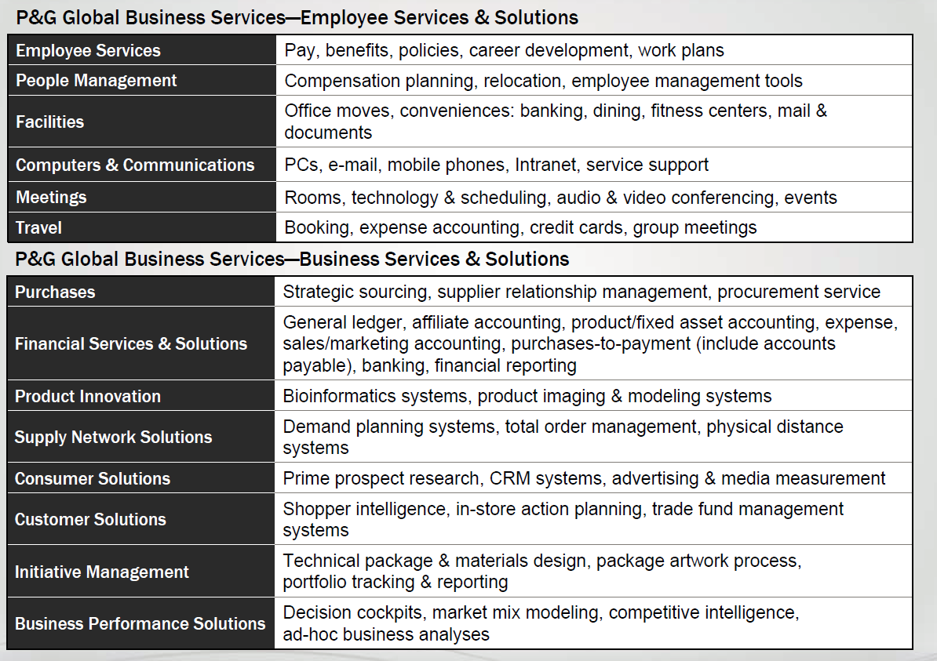
Diversification Model P & G example

Slide 72
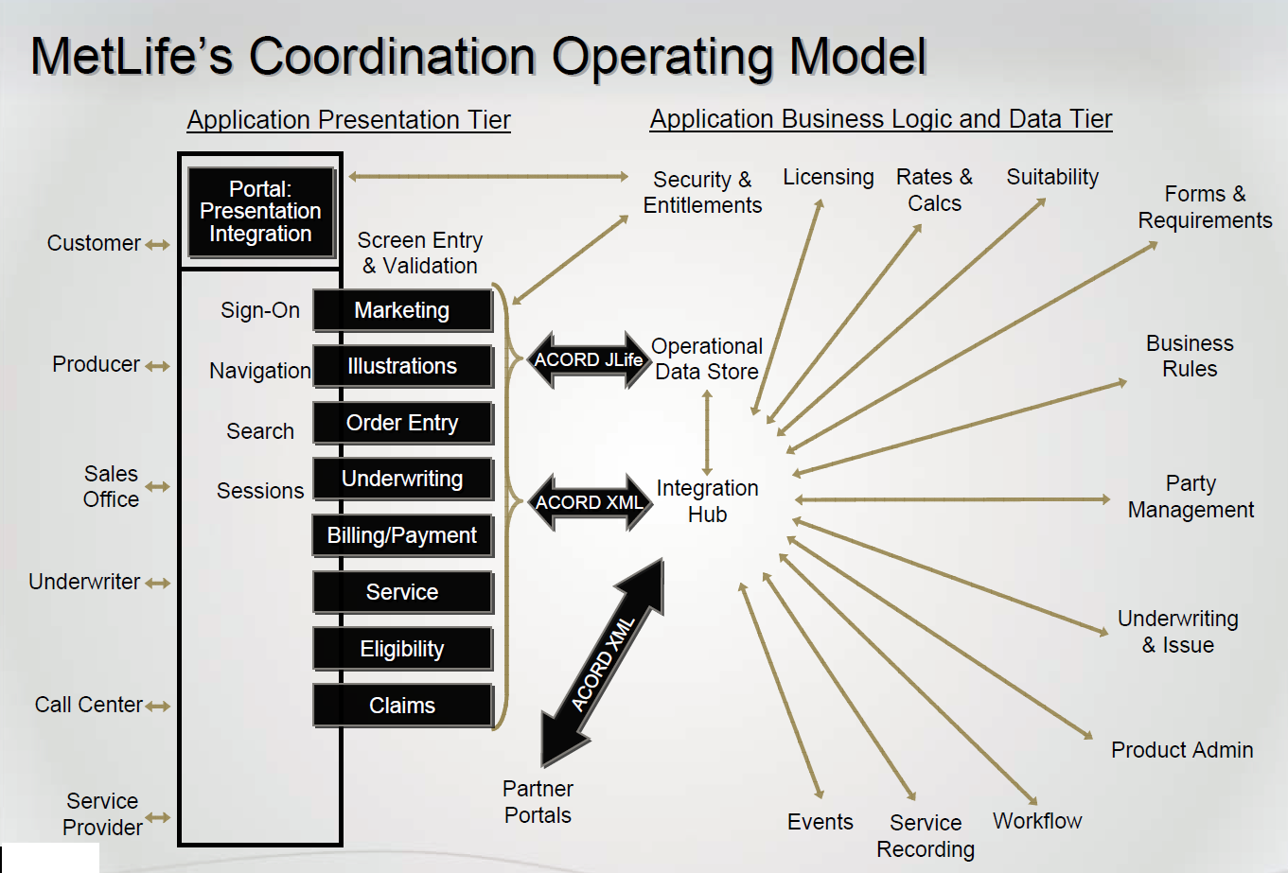
Coordination Operating Model MetLife’s example

Slide 73
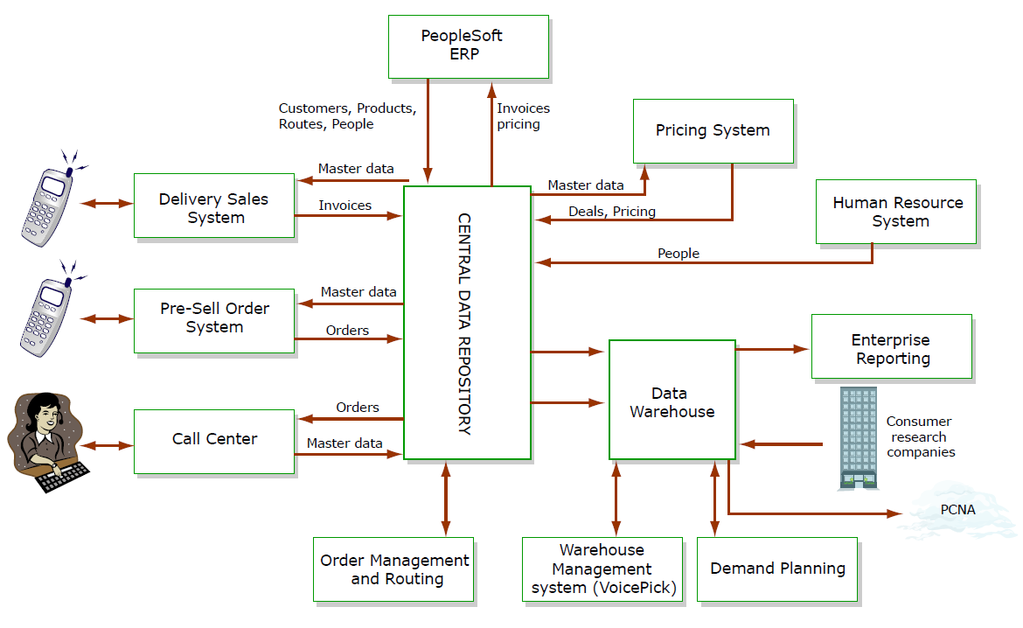
Coordination Operating Model Pepsi Americas Information backbone integraiton

Slide 74
The Coordination Operating Model Platform
Focuses on providing data visibility to meet customer needs
- single face to customer
- End-to-end business processes
Allows customisation of services according to customer needs and encourages local expertise while leveraging global products and services
The platform can be extended as firms add markets or products
The platform demands disciplined use of data – preservation of data standards; timely input of data
As products and services become commodities, can move toward unification; coordination is not a low-cost model
Less prone to disruption than unification and replication models

Slide 75
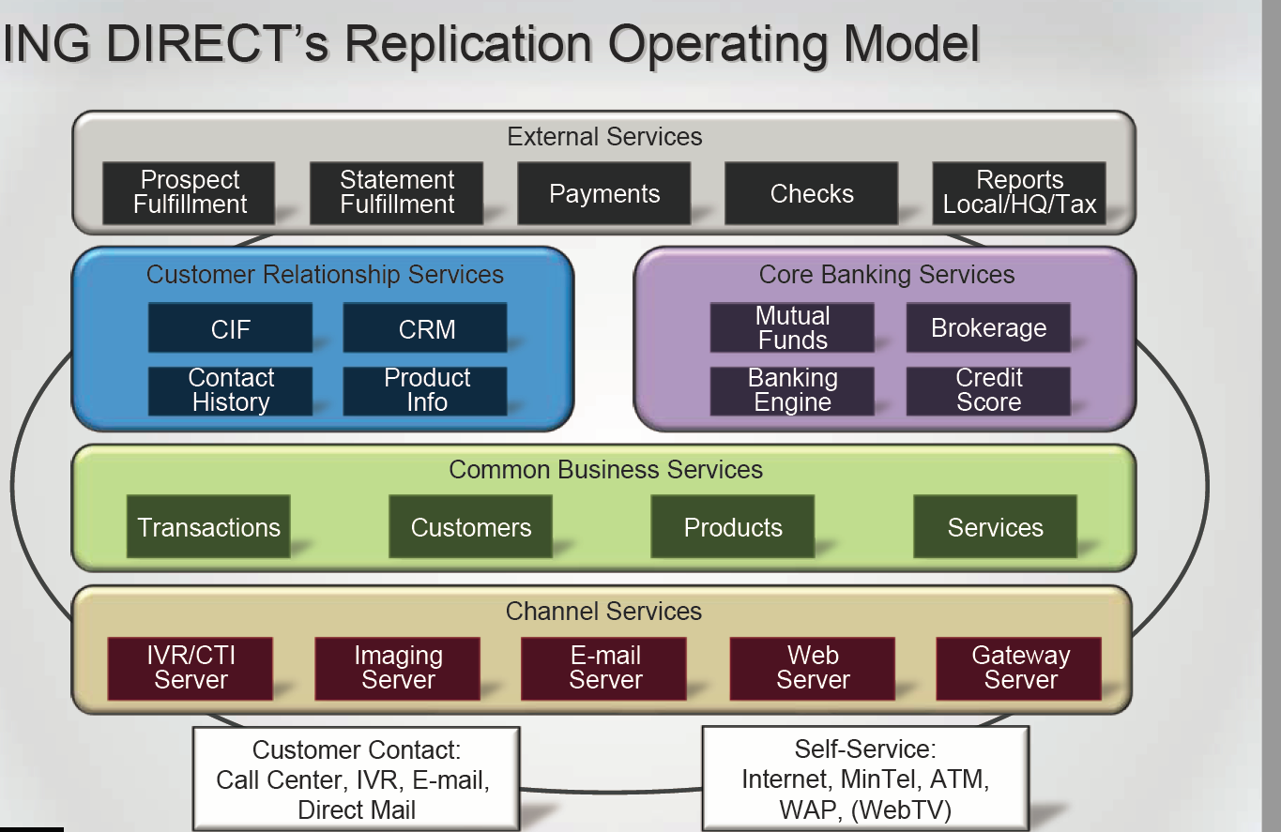
ING Directs’s Replication Operating Model

Slide 76
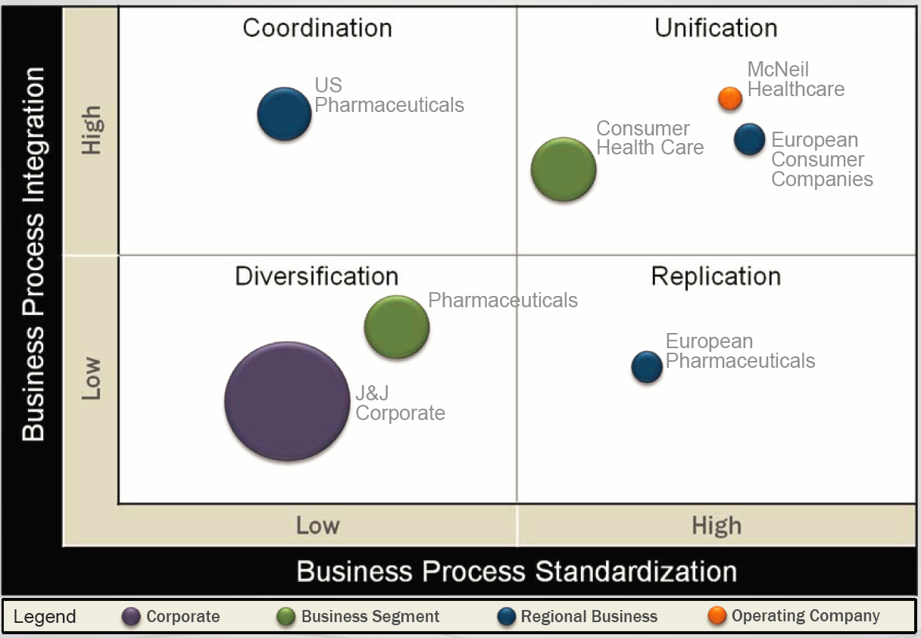
Johnson & johnson’s Multiple Operating Models

Slide 77
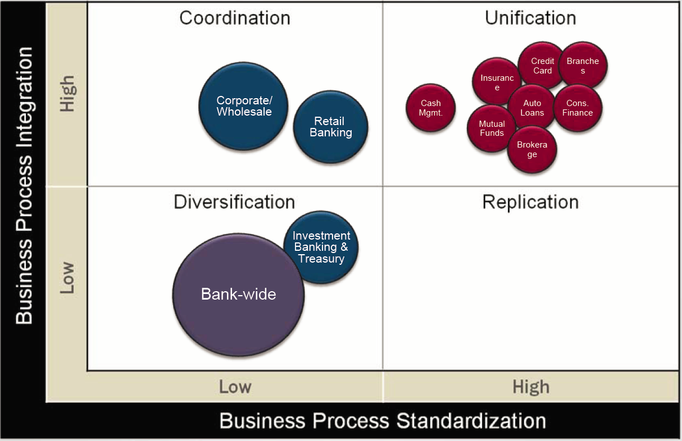
Target’s Operating Model of One Full-Service bank

Slide 78
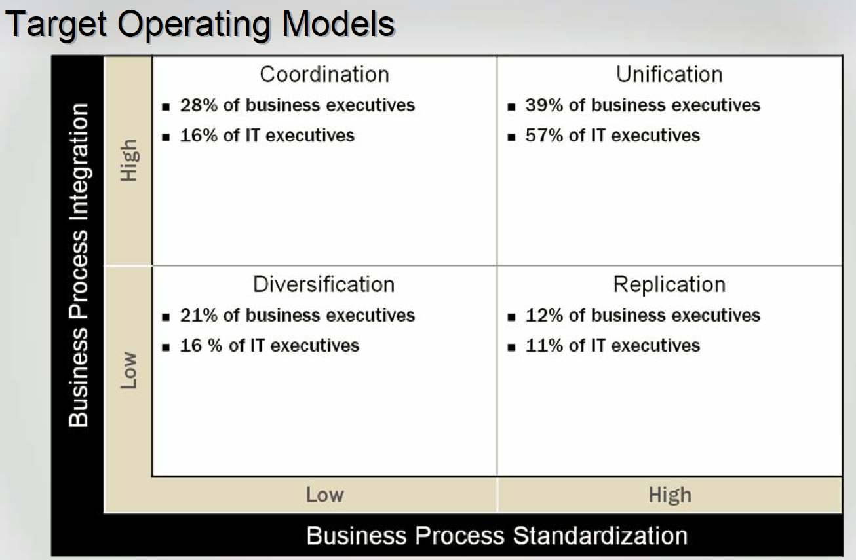

Slide 79
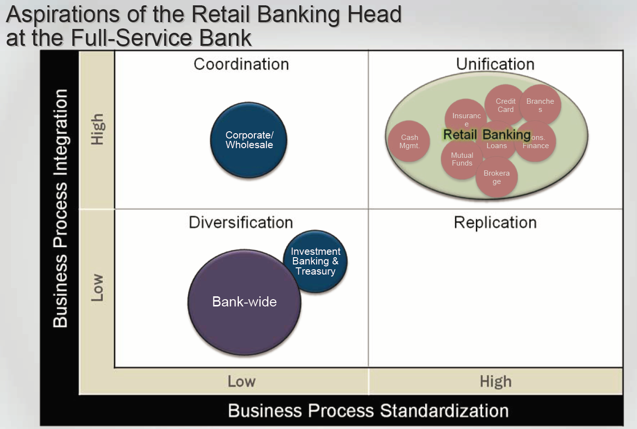
Aspirations of the Retail head at the Full-Service bank

Slide 80
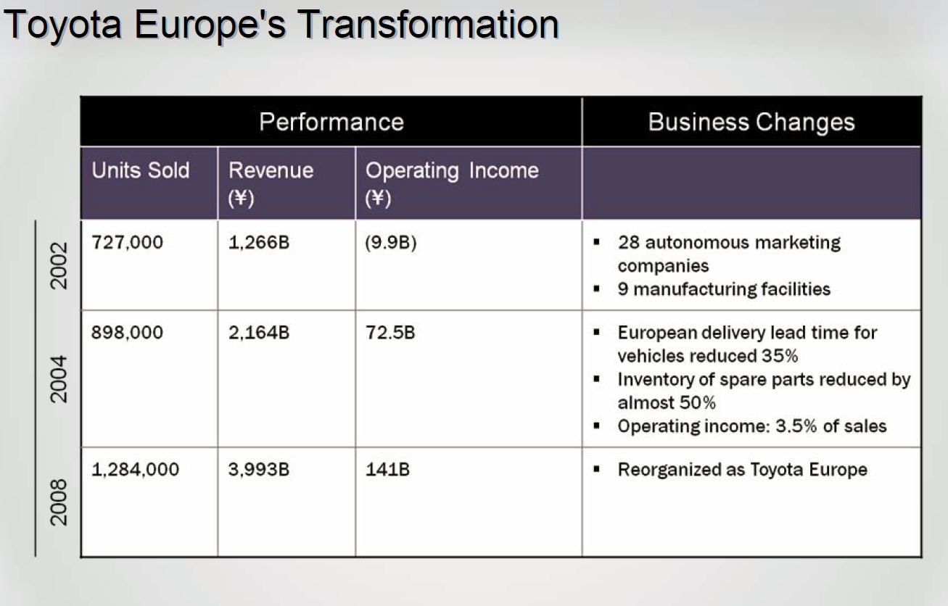
Business Tranformation at Toyota Europe
Toyota Motors Marketing Europe 2002
Sales growing dramatically:
-384,000 units in 1995
-727,000 units in 2002
Toyota Europe structured as 28 independently managed country operations
-cars and parts ordered from 9 European manufacturing plants
-All products and spare parts inventories managed within countries
-Little transparency of supply and demand
-different systems and processes in each country
Operating loss FY 2002 Yen 9.9B

Slide 81

Questions

Slide 82
Links for useful resources
https://hbr.org/2017/01/a-good-digital-strategy-creates-a-gravitational-pull
https://www.weforum.org/agenda/2017/01/jack-ma-three-trends-define-future?utm_content=bufferc0a5e&utm_medium=social&utm_source=twitter.com&utm_campaign=buffer
http://www.digitalmind.ee/business-technology-trends-for-2017/
https://enterprisersproject.com/article/2016/11/2016-digital-transformation-book-contest
https://www.weforum.org/agenda/2016/02/davos-2016-and-the-fourth-industrial-revolution/
https://www.weforum.org/agenda/2016/06/top-10-emerging-technologies-2016/
https://www.weforum.org/agenda/2016/10/2017s-most-in-demand-skills-according-to linkedin?utm_content=buffer23af8&utm_medium=social&utm_source=facebook.com&utm_campaign=buffer

Slide 83

Next Session: 19.09.18 Systems Analysis -Feasibility Assessment -Case Study [Business Process Management]

